Slide 1

Antipsychotics
Presented by:
Ghazi Majali
Supervised by:
Dr-Amer Rawajfeh

Slide 2
Introduction
Antipsychotics are used to treat psychotic disorders as well as psychotic symptoms associated with other psychiatric and medical illnesses.
Antipsychotic drugs are not curative and do not eliminate chronic thought disorders, but they often decrease the intensity of hallucinations and delusions and permit the person with schizophrenia to function in a supportive environment.
The use of antipsychotic medications involves a difficult trade-off between the benefit of alleviating psychotic symptoms and the risk of a wide variety of troubling adverse effects.

Slide 3
Classification of antipsychotics
The antipsychotic drugs are divided into first- and second-generation agents.
The first-generation drugs are further classified as “low potency” or “high potency.”

Slide 4
Classification of antipsychotics cont.
Both typical and atypical antipsychotics have similar efficacies in treating the presence of positive psychotic symptoms, such as hallucinations and delusions.
Atypical antipsychotics may be more effective in treating negative symptoms of schizophrenia than typical antipsychotics.
In terms of side effects:
-First-generation antipsychotics are more likely to be associated with movement disorders known as extrapyramidal symptoms (EPS).
-However, the risk of metabolic syndrome/weight gain and other side effects is higher in second-generation antipsychotics.
Notes:
*The choice of which specific medication to prescribe should be made based on the patient’s individual clinical presentation, past response (favorable and unfavorable), side-effect profile, and preference.

Slide 5
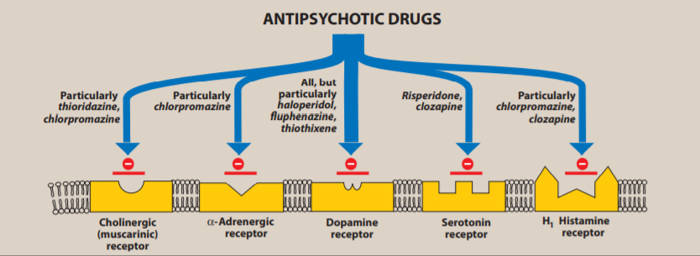
Mechanism Of Action
Typical or first-generation antipsychotics, sometimes referred to as neuroleptics, treat psychosis by blocking dopamine (D2) receptors and are further classified according to potency.
Atypical or second-generation antipsychotics block both dopamine (D2) and serotonin (5-HT) receptors, particularly 5-HT2A receptors
The antipsychotic effect of these drugs is achieved by blocking dopamine receptors in the mesolimbic system.

Slide 6
Side effects of antipsychotics
Side effects happen due to blockade of dopamine receptors outside the mesolimbic system (e.g. nigrostriatal pathway and tuberoinfundibular area.) and blockade of other receptors (e.g. cholinergic, adrenergic and histamine receptors.).
Extrapyramidal effects:
■ Parkinsonism—bradykinesia, masklike face, cogwheel rigidity, pillrolling tremor.
■ Akathisia—subjective anxiety and restlessness, objective fidgetiness. Patients may report a sensation of inability to sit still. Best treated with β-blockers or benzodiazepines.
■ Dystonia—sustained painful contraction of muscles of neck (torticollis), tongue, eyes (oculogyric crisis). It can be life threatening if it involves the airway or diaphragm.

Slide 7
EPS cont.
■ Tardive Dyskinesia (TD): Choreoathetoid movements (involuntary, irregular twisting contractions) of mouth and tongue (or other body parts) that may occur in patients who have used neuroleptics for more than 6 months.
-Older age is a risk factor.
-Women and patients with affective disorders may be at an increased risk.
-Although 50% of cases will remit (without further antipsychotic use), most cases are permanent. Treatment involves discontinuation of current antipsychotic if clinically possible and changing to a medication with less potential to cause TD.

Slide 8
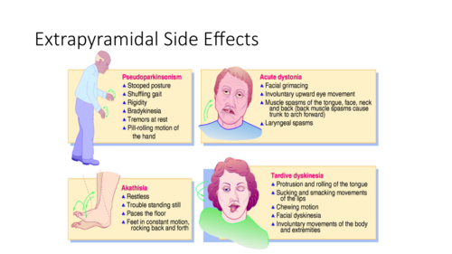

Slide 9
Side effects cont.
Hyperprolactinemia —Leads to decreased libido, galactorrhea, gynecomastia, impotence and amenorrhea.
Hyperprolactinemia occurs due to dopamine blockade in the tuberoinfundibular pathway.

Slide 10
Side effects cont.
Anti-HAM effects: Caused by actions on Histaminic, Adrenergic, and Muscarinic receptors:
■ Antihistaminic—results in sedation, weight gain.
■ Anti-α1 adrenergic—results in orthostatic hypotension, cardiac abnormalities, and sexual dysfunction.
■ Antimuscarinic—anticholinergic effects, resulting in dry mouth, tachycardia, urinary retention, blurry vision, constipation, and precipitation of narrow-angle glaucoma.

Slide 11
Side effects cont.
Neuroleptic Malignant Syndrome:
-Though rare, it is a medical emergency and has up to a 20% mortality rate if left untreated.
-It is characterized by: (FALTERED)
Fever (most common presenting symptom), Autonomic instability (tachycardia, labile hypertension, diaphoresis), Leukocytosis, Tremor, Elevated CPK, Rigidity (lead pipe rigidity is considered almost universal), Excessive sweating (diaphoresis), Delirium (mental status changes).
-Treatment involves discontinuation of current medications and administration of supportive medical care (hydration, cooling, etc.). Sodium dantrolene, bromocriptine, and amantadine may be used but have their own side effects and unclear efficacy.
-Note: This is not an allergic reaction.

Slide 12
Side effects cont.
Other side effects:
■ Elevated liver enzymes, jaundice.
■ Ophthalmologic problems (irreversible retinal pigmentation with high doses of thioridazine, deposits in lens and cornea with chlorpromazine).
■ Dermatologic problems, including rashes and photosensitivity (blue-gray skin discoloration with chlorpromazine).
■ Seizures: All antipsychotics lower the seizure threshold, although low-potency antipsychotics are more likely to do so.

Slide 13
Side effects cont.
■ Metabolic syndrome:
-This must be monitored with baseline weight, waist circumference, BP, HbA1c, and fasting lipids.
-Weight gain: Metformin can be used to reduce or prevent.
-Hyperlipidemia.
-Hyperglycemia.

Slide 14
First-generation/Typical antipsychotics

Slide 15
Low potency group
Lower affinity for dopamine receptors and therefore a higher dose is required.
Higher incidence of antiadrenergic, anticholinergic, and antihistaminic side effects compared to high-potency typical antipsychotics.
Lower incidence of EPS and (possibly) neuroleptic malignant syndrome.
More lethality in overdose due to QTc prolongation, and the potential for heart block and ventricular tachycardia.
Rare risk for agranulocytosis, and slightly higher seizure risk than high potency antipsychotics.

Slide 16
Low potency group
Chlorpromazine:
■ Commonly causes orthostatic hypotension.
■ Can cause blue-gray skin discoloration as well as corneal and lens deposits.
■ Can lead to photosensitivity.
■ Also used to treat nausea and vomiting, as well as intractable hiccups.
Thioridazine: Associated with retinitis pigmentosa.

Slide 17
Midpotency
Have midrange properties.
Loxapine:
■ Higher risk of seizures.
■ Metabolite is an antidepressant.
Thiothixene: Can cause ocular pigment changes.
Molindone.
Perphenazine.

Slide 18
High-Potency
■ Greater affinity for dopamine receptors; therefore, a relatively low dose is needed to achieve effect.
■ Less sedation, orthostatic hypotension, and anticholinergic effects.
■ Greater risk for extrapyramidal symptoms and (likely) tardive dyskinesia.
Haloperidol: Can be given PO/IM/IV. Decanoate (long acting form) available.
Fluphenazine: Decanoate form available.
Trifluoperazine: Approved for nonpsychotic anxiety.
Pimozide: Associated with QTc prolongation and ventricular tachycardia.

Slide 19
Second-generation/Atypical antipsychotics
-Atypical antipsychotics are also used to treat acute mania, bipolar disorder, and as adjunctive medications in unipolar depression.
-They are also used in treating borderline personality disorder, PTSD, and certain psychiatric disorders in childhood (e.g., tic disorders).

Slide 20
Second-generation/Atypical antipsychotics
Clozapine:
■ Less likely to cause tardive dyskinesia.
■ Only antipsychotic shown to be more efficacious than the others; used in treatment refractory schizophrenia.
■ More anticholinergic side effects than other atypical or high potency typical antipsychotics. Associated with tachycardia and hypersalivation.
■ Risk of severe side effects:
-One percent incidence of agranulocytosis; clozapine must be stopped if the absolute neutrophil count drops below 1500 per microliter.
-Four percent incidence of seizures.
-Small risk of myocarditis.

Slide 21
Second-generation/Atypical antipsychotics
Risperidone:
■ Can cause increased prolactin.
■ Associated with orthostatic hypotension and reflex tachycardia.
■ There is a long-acting injectable form.
Quetiapine:
■ Much less likely to cause EPS; common side effects include sedation and orthostatic hypotension.
Olanzapine:
■ Common side effects include weight gain, sedation, and dyslipidemia.

Slide 22
Second-generation/Atypical antipsychotics
Ziprasidone:
■ Less likely to cause significant weight gain, associated with QTc prolongation, and must be taken with food.
Aripiprazole:
■ Unique mechanism of partial D2 agonism.
■ Can be more activating (akathisia) and less sedating.
■ Less potential for weight gain.

Slide 23
- Newer (more expensive) antipsychotics:
Paliperidone:
■ Metabolite of risperidone.
Asenapine.
Iloperidone.
Lurasidone:

